Slide 1
ISSDM Trust Collaboration
Bo Adler, Luca de Alfaro, Ian Pye, Shelly Spearing, Jorge Roman
This project focuses on evaluating contributions to collaborative content. We measure both author reputation and textual stability. Starting from our existing work on wikis, the project will expand to include new content formats, including email, multi-media, discussion groups and blogs.
•Title: WikiTrust
•Brief Summary of Accomplishments
o Finalized Integration of WikiTrust with Wikimedia Foundation; Submitted paper on reputation for email-based discussion groups; Created semantic crawler for wikis; Launched French, German, Italian, Polish colored wikis.
o Created publicity for UCSC and LANL via publication of our WikiTrust demos.
o Statistics
▪Associate Professor Luca de Alfaro, UCSC
▪Ian Pye (4rd year Ph.D. student), Bo Adler (6th year Ph.D. student) (UCSC)
▪UCSC
▪Shelly Spearing, Jorge Roman
▪Scientific Software Engineering Group
▪-
▪I. Pye and L. de Alfaro. A Reputation System for Email-Based Discussion Groups. WWW 2010. K. Chatterjee, L. de Alfaro, I. Pye. Robust Content-Driven Reputation. In The First ACM Workshop on AISec, 2008. Published; B.T. Adler, K. Chatterjee, L. de Alfaro, M. Faella, I. Pye, V. Raman. Assigning Trust to Wikipedia Content. In WikiSym 2008: International Symposium on Wikis. Published; B.T. Adler, L. de Alfaro, I. Pye, V. Raman. Measuring Author Contributions to the Wikipedia. In WikiSym 2008: International Symposium on Wikis. Published; B.T. Adler, L. de Alfaro. A Content-Driven Reputation System for the Wikipedia. In WWW 2007, Proceedings of the 16th International World Wide Web Conference, ACM Press, 2007. Published. I. Pye. Ringer: Distributed Naming on a Global Scale. Master's Project, UC Santa Cruz, 2008.
▪-
▪Presentation – Wikisym 2009. Orlando FL.
▪-
▪-
▪-
▪-
▪-
▪-
•Other Accomplishments? -

Slide 2
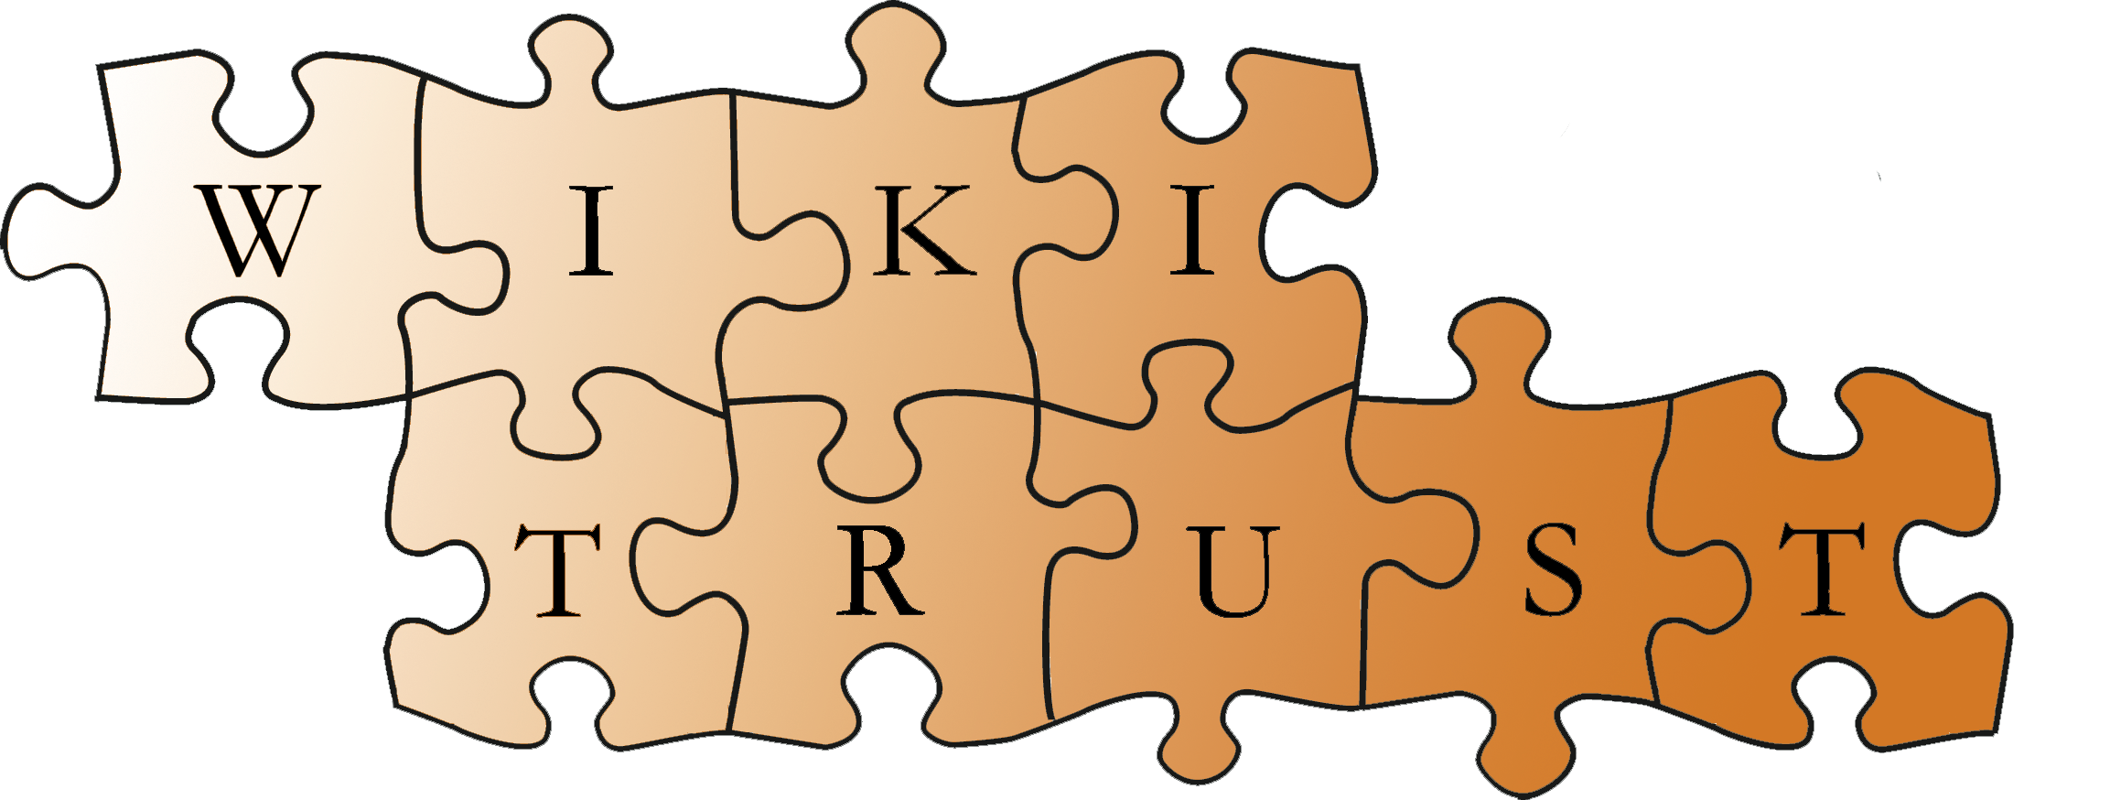
Our Work in Context
Reputation = How people respond to your edits
Reputation = How people respond to your postings
Newsgroups:
Reputation = How people respond to content you create
Generally:

Slide 3
Wiki Demos
http://de.redherring.soe.ucsc.edu/index.php/Channel_Country?trust
Semantic Crawler
SCrawl is a tool to extract what text MIGHT be interesting.
Works though semantic meaning.
Achieve high recall without sacrificing too much precision.
Parallel processing for large datasets.

Slide 4
Results...
Agreement in principle to launch WikiTrust on Wikipedia
In preparation, downloading the current English Wikipedia to UCSC (Done!)
Current live demos of French, Italian, German, and Polish Wikipedia colored for trust
Setup to run SCrawl on LANL’s DISC
Submitted work on newsgroup reputation to WWW (accept/reject date is late January)
Presented workshop on WikiTrust at WikiSym
and Goals
Release WikiTrust 1.0, running directly on the English Wikipedia
Release “Stable Revisions” tool
Complete runs of SCrawl for different seed pages
Advance (Ian)

